Slide 1

History in Data
Nick Forte

Slide 2
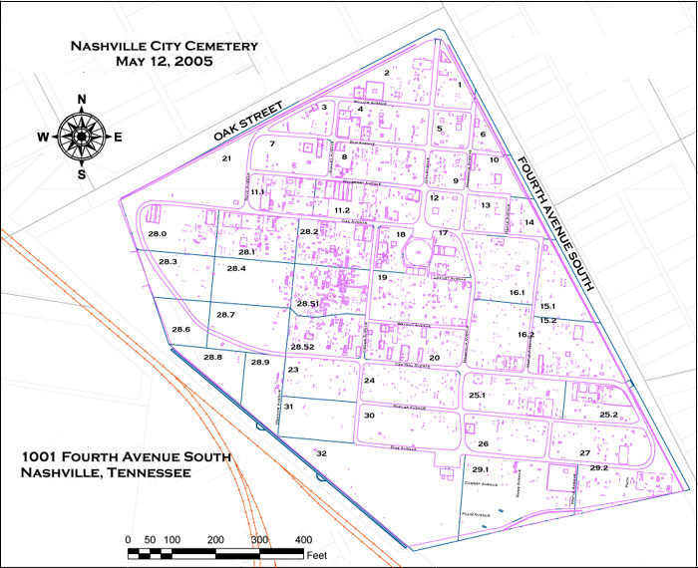

Slide 4
Most Common Last Names
Smith | 129
Brown | 112
Johnson | 96
Jones | 83
Williams | 70

Slide 5
Deaths by Age Group

